Slide 1
Electronic Devices and Circuits Lecture-2
CSE 223
Prepared by
Ipshita Tasnim Raha
Lecturer (Provisional)
Dept. of CSE
Varendra University

Slide 2
Extrinsic Semiconductors (Review)
The conductive characteristic of an intrinsic semiconductor can be altered significantly by adding a small amount of suitable impurity atoms into it. The process of adding impurities to intrinsic semiconductor is known as doping. And an intrinsic semiconductor material that has been subjected to the doping process is called an extrinsic semiconductor material.
Depending upon the type of impurity added, extrinsic semiconductors are classified into two types. They are,
n-type semiconductor
p-type semiconductor

Slide 3
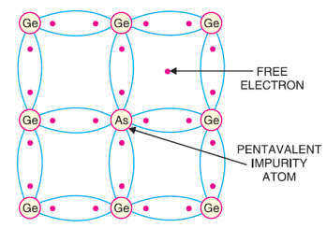
n-type semiconductor
When a small amount of pentavalent impurity is added to a pure semiconductor, it is known as n-type semiconductor.
The addition of pentavalent impurity provides a large number of free electrons in the semiconductor crystal. Typical examples of pentavalent impurities are arsenic (Atomic Number 33) and antimony (Atomic Number 51). Such impurities which produce n-type semiconductor are known as donor impurities because they donate or provide free electrons to the semiconductor crystal.

Slide 4
n-type semiconductor
To explain the formation of n-type semiconductor, consider a pure germanium crystal. We know that germanium atom has four valence electrons. When a small amount of pentavalent impurity like arsenic is added to germanium crystal, a large number of free electrons become available in the crystal.
The reason is, Arsenic is pentavalent that is, its atom has five valence electrons. An arsenic atom fits in the germanium crystal in such a way that its four valence electrons form covalent bonds with four germanium atoms. The fifth valence electron of arsenic atom finds no place in co-valent bonds and is thus free.
Therefore, for each arsenic atom added, one free electron will be available in the germanium crystal. Though each arsenic atom provides one free electron, yet an extremely small amount of arsenic impurity provides enough atoms to supply millions of free electrons.

Slide 5
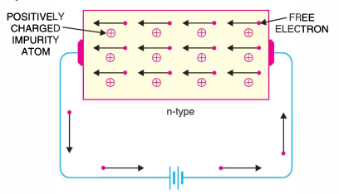
n-type semiconductor conductivity

Slide 6
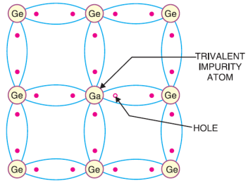
p-type semiconductor
When a small amount of trivalent impurity is added to a pure semiconductor, it is called p-type semiconductor.
The addition of trivalent impurity provides a large number of holes in the semiconductor. Typical examples of trivalent impurities are gallium (Atomic Number 31) and indium (Atomic Number 49). Such impurities which produce p-type semiconductor are known as acceptor impurities because the holes created can accept the electrons.

Slide 7
p-type semiconductor
To explain the formation of p-type semiconductor, consider a pure germanium crystal.
When a small amount of trivalent impurity like gallium is added to germanium crystal, there exists a large number of holes in the crystal. The reason is, Gallium is trivalent that is, its atom has three valence electrons. Each atom of gallium fits into the germanium crystal but now only three covalent bonds can be formed. It is because three valence electrons of gallium atom can form only three single co-valent bonds with three germanium atoms.
In other words, fourth bond is incomplete being short of one electron. This missing electron is called a hole. Therefore, for each gallium atom added, one hole is created. A small amount of gallium provides millions of holes.

Slide 8
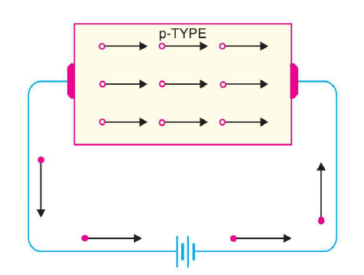
p-type semiconductor Conductivity

Slide 9
Charge on P-type and n-typeSemiconductors
It is true that n-type semiconductor has excess of electrons but these extra electrons were supplied by the atoms of donor impurity and each atom of donor impurity is electrically neutral.
When the impurity atom is added the term excess electrons refers to an excess with regards to the number of electrons needed to fill the covalent bonds in semiconductor crystal.
The extra electrons are free electrons and increase the conductivity of the semiconductor. This situation with regard to p-type semiconductor is also similar.
So it follows, therefore that n-type as well as p-type semiconductor is electrically neutral.

Slide 10
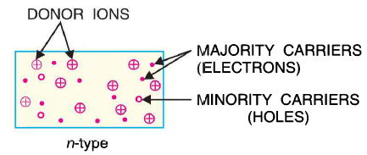
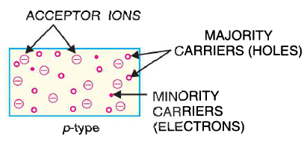
Majority and Minority Carriers
N-type material has a large number of free electrons. And a small number of holes
P-type material has a large number of holes. And a small number of electrons

Slide 11
n-type & p-type conductivity
Let’s watch a video
Link: https://www.youtube.com/watch?v=CM0C7gWMcyw
https://www.youtube.com/watch?v=5ZNeDxfgYAE

Slide 12
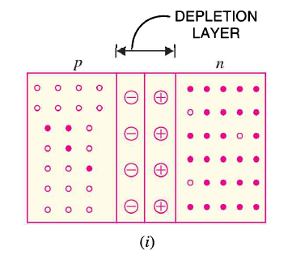
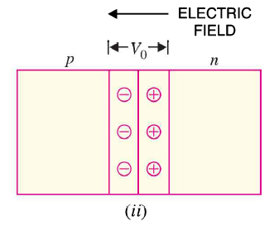
P N junction of semiconductor

Slide 13
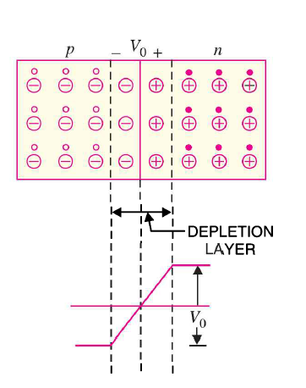
P N junction of semiconductor

Slide 14
Semiconductor Diode:

Slide 15
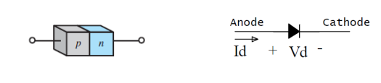
Properties of Semiconductor
The semiconductor diode is created by simply joining a p-type and an n-type material together.
It is represented by the following symbols, where the arrow indicates the direction of positive current flow. These are generally used for rectifiers. It is also called the p-n junction diode.

Slide 16
How a P N junction semiconductor works
Let’s watch a video
Link: https://www.youtube.com/watch?v=OyC02DWq3mI

Slide 17
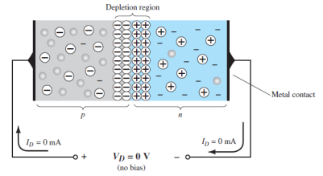
No Applied Bias (V_{D}= 0V)
At the instant the two materials are joined the electrons and the holes in the region of the junction will combine, resulting in a lack of free carriers in the region near the junction.
If leads are connected to the ends of each material, a two-terminal device results as the given picture.
Three options then become available:
no bias
forward bias
reverse bias

Slide 18
No Applied Bias (V_{D}= 0V)
The term bias refers to the application of an external voltage across the two terminals of the device to extract a response.
The condition shown in figure is the no-bias situation because there is no external voltage applied. In the figure it is clear that the applied voltage is 0 V (no bias) and the resulting current is 0 A, much like an isolated resistor. The absence of a voltage across a resistor results in zero current through it.

Slide 19
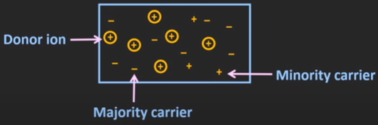
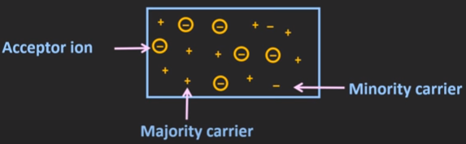
Important Terms
N-type
P-type

Slide 20
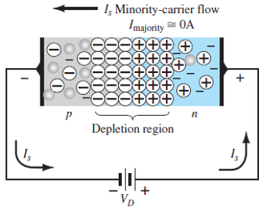
Reverse - Bias Condition (V_{D} < 0V)
If an external potential of V volts is applied across the p – n junction such that the positive terminal is connected to the n -type material and the negative terminal is connected to the p –type material, the number of uncovered positive ions in the depletion region of the n -type material will increase due to the large number of free electrons drawn to the positive potential of the applied voltage.
For similar reasons, the number of uncovered negative ions will increase in the p-type material. The net effect, therefore, is a widening of the depletion region. This widening of the depletion region will establish too great a barrier for the majority carriers to overcome, effectively reducing the majority carrier flow to zero. The current that exists under reverse-bias conditions is called the reverse saturation current and is represented by Is.

Slide 21
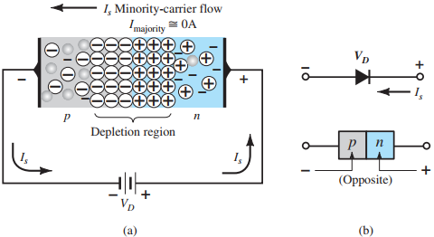
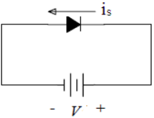
Reverse - Bias Condition (V_{D} < 0V)
Fig: The reverse bias circuit using diode
Fig: Reverse-biased p–n junction:
(a) internal distribution of charge under reverse-bias conditions
(b)reverse-bias polarity and direction of reverse saturation current.

Slide 22
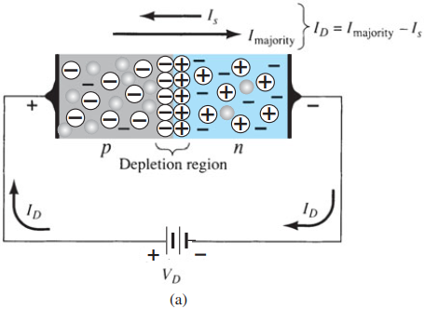
Forward - Bias Condition (V_{D} > 0V)
A forward-bias or “on” condition is established by applying the positive potential to the p –type material and the negative potential to the n -type material. The application of a forward-bias potential V_{D} will “pressure” electrons in the n -type material and holes in the p -type material to recombine with the ions near the boundary and reduce the width of the depletion.
The resulting minority-carrier flow of electrons from the p -type material to the n -type material and of holes from the n -type material to the p -type material has not changed in magnitude since the conduction level is controlled primarily by the limited number of impurities in the material, but the reduction in the width of the depletion region has resulted in a heavy majority flow across the junction.

Slide 23
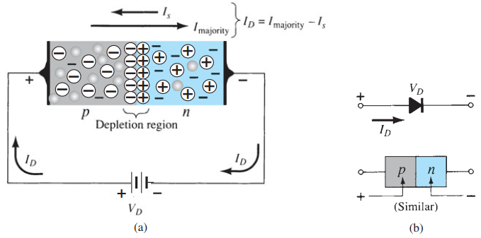
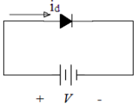
Forward - Bias Condition (V_{D} > 0V)
Fig: The forward bias circuit using diode
Fig: Forward-biased p–n junction:
(a) internal distribution of charge under forward-bias conditions
(b) forward-bias polarity and direction of resulting current.

Slide 24
Characteristics of Diode:
Diode always conducts in one direction.
Diodes conduct current when Forward Biased (Zero resistance)
Diodes do not conduct when Reverse Biased (Infinite resistance)

Slide 25
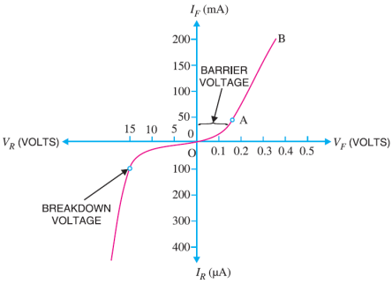
V-I Characteristics of pn junction
Volt-ampere or V-I characteristic of a p-n junction is the curve between voltage across the junction and the circuit current. Usually, voltage is taken along x-axis and current along y-axis.
The characteristics can be studied under three heads
Zero external voltage
Forward bias and
Reverse bias

Slide 26
V-I Characteristics of pn junction
Zero external voltage: When the external voltage is zero, that is, circuit is open, the potential barrier at the junction does not permit current flow. Therefore, the circuit current is zero as indicated by point O in the figure.
Forward bias: With forward bias to the p-n junction that is, p-type connected to positive terminal and n-type connected to negative terminal, the potential barrier is reduced. At some forward voltage (0.7 V for Si and 0.3 V for Ge), the potential barrier is altogether eliminated and current starts flowing in the circuit. From now onwards, the current increases with the increase in forward voltage. Thus, a rising curve OB is obtained with forward bias as shown in the Figure
Reverse bias: With reverse bias to the p-n junction that is, p-type connected to negative terminal and n-type connected to positive terminal, potential barrier at the junction is increased. Therefore, the junction resistance becomes very high and practically no current flows through the circuit.

Slide 27
V-I Characteristics of pn junction
However, in practice, a very small current (of the order of μA) flows in the circuit with reverse bias as shown in the reverse characteristic. This is called reverse saturation current (Is) and is due to the minority carriers. It may be recalled that there are a few free electrons in p-type material and a few holes in n-type material. These undesirable free electrons in p-type and holes in n-type are called minority carriers. To these minority carriers, the applied reverse bias appears as forward bias.
Therefore, a small current flows in the reverse direction. If reverse voltage is increased continuously, the kinetic energy of electrons (minority carriers) may become high enough to knock out electrons from the semiconductor atoms. At this stage breakdown of the junction occurs, characterized by a sudden rise of reverse current and a sudden fall of the resistance of barrier region. This may destroy the junction permanently.

Slide 28
Important Terms
Breakdown voltage: It is the minimum reverse voltage at which p-n junction breaks down with sudden rise in reverse current.
Knee voltage: It is the forward voltage at which the current through the junction starts to increase rapidly.

Slide 29
Limitations in the Operating Conditions of
p-n Junction
Every p-n junction has limiting values of maximum forward current, peak inverse voltage and maximum power rating. The p-n junction will give satisfactory performance if it is operated within these limiting values. However, if these values are exceeded, the p-n junction may be destroyed due to excessive heat.
Maximum forward current: It is the highest instantaneous forward current that a p-n junction can conduct without damage to the junction. Manufacturer’s data sheet usually specifies this rating. If the forward current in a p-n junction is more than this rating, the junction will be destroyed due to overheating.
Peak inverse voltage (PIV): It is the maximum reverse voltage that can be applied to the p-n junction without damage to the junction. If the reverse voltage across the junction exceeds its PIV, the junction may be destroyed due to excessive heat.
Maximum power rating: It is the maximum power that can be dissipated at the junction without damaging it. The power dissipated at the junction is equal to the product of junction current and the voltage across the junction. This is a very important consideration and is invariably specified by the manufacturer in the data sheet.

Slide 30
p-n junction
Let’s review
Link: https://www.youtube.com/watch?v=JBtEckh3L9Q

Slide 31

Quiz Time!
A brief assessment
Don’t Worry!
A quiz is a form of game or mind sport.

Slide 32
When a pentavalent impurity is added to a pure semiconductor, it becomes _____
In a semiconductor, current conduction is due to ______
Only holes
Only free electrons
Holes and free electrons
None of the above
The barrier voltage at a pn junction for germanium is about _____
The leakage current across a pn junction is due to ______
Minority carriers
Majority carriers
Junction capacitance
5. With forward bias to a pn junction , the width of depletion layer _____
Decreases
Increases
Remains the same
None of the above
6. At room temperature, an intrinsic silicon crystal acts approximately as ……
A battery
A conductor
An insulator

Slide 33
Think Like A Proton
Always Positive

Slide 34
Thanks!
Any questions?

